Slide 1


Final Project – Data Science
Submitted by: Shafir Hafif and Itzhak Keidar

Slide 2

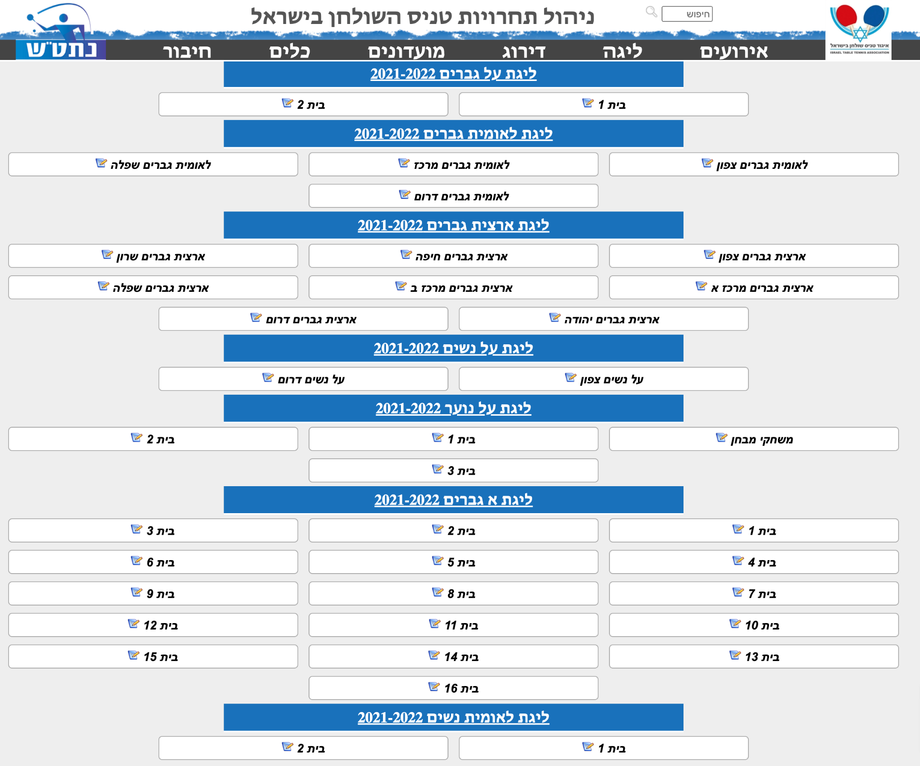
Background
We both come from different but similar sports,
With less budget than most popular sports in Israel.
Therefore there isn’t enough data and statistics over the internet and we thought that with this assignment we can improve that.
As a players we wanted to figure out if and how we can determine a match outcome.
Table Tennis in Israel:
Small sport, growing over time,
With over 1200 active league players and hundreds that are non professionals.
In the past the sport was managed through several companies but today there is only one main organization that has all the necessary data on this sport.
Examples of professional events:
Super league, regional competitions etc...

Slide 3
External Sources
http://www.tttm.co.il/ - all the relevant data
https://scikit-learn.org/stable/ - for the machine learning
https://matplotlib.org/ - EDA
www.campus.gov.il – additional help from course notebooks

Slide 4

Crawling

Slide 5
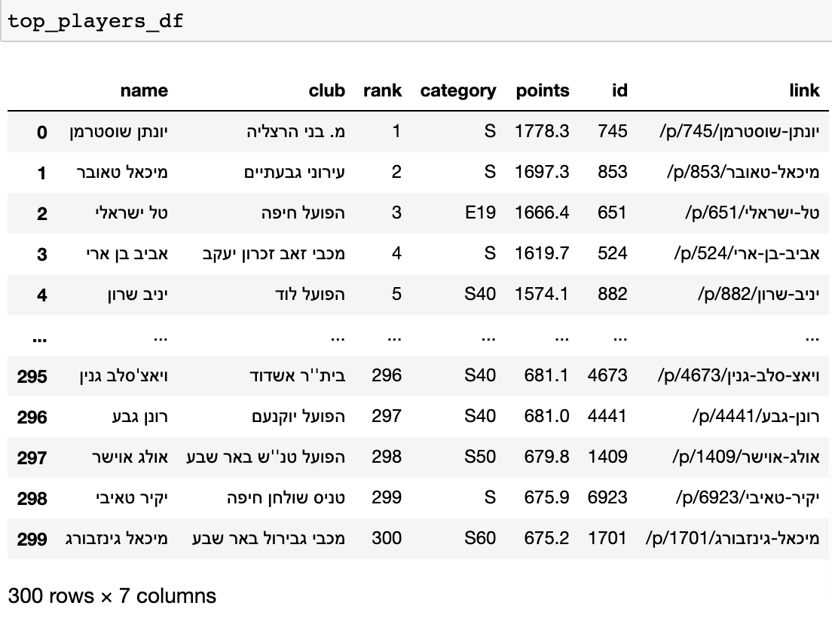
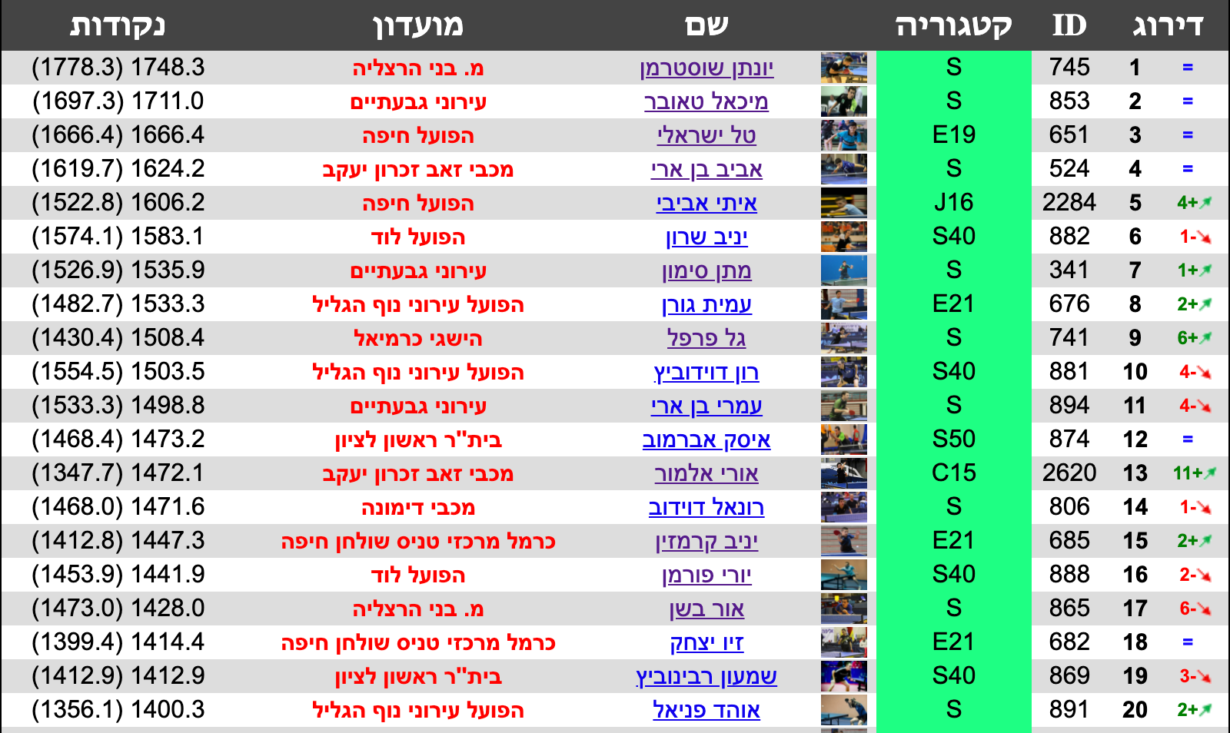
Step 1:
In the first part we acquired some dry data in order to get the top 300 players
Example of the Dataframe
The structure:
Player’s name
Player’s club
Rank
Category
Points
Id
Relevant page link
The data was taken from this link:
http://www.tttm.co.il/rk/MS-1/%D7%98%D7%A0%D7%99%D7%A1-%D7%A9%D7%95%D7%9C%D7%97%D7%9F-%D7%93%D7%99%D7%A8%D7%95%D7%92-%D7%92%D7%91%D7%A8%D7%99%D7%9D
At this point we collected 300 rows of players and 7 relevant columns

Slide 6
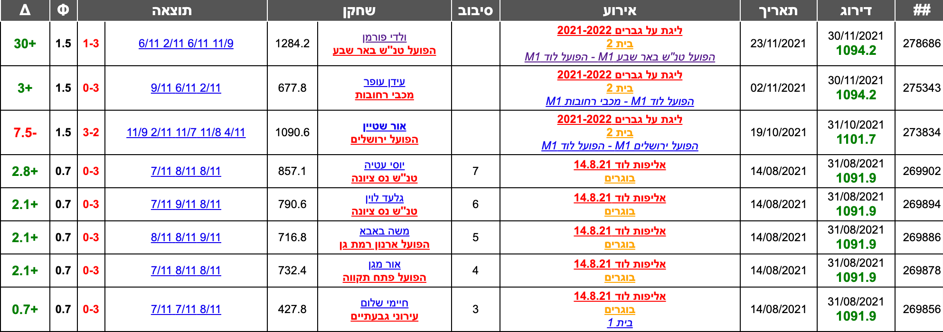
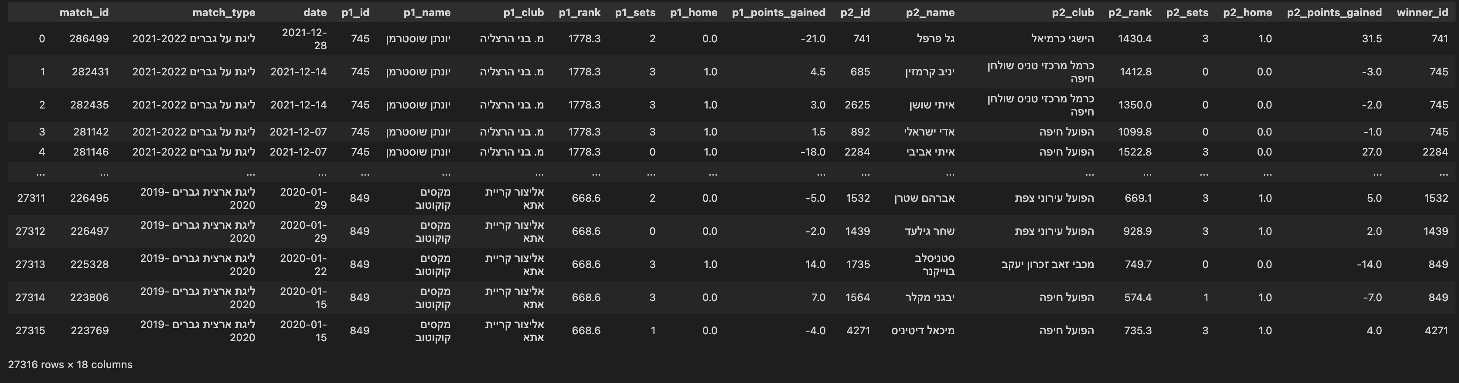
Step 2:
In this part we iterated over all of the players and in each personal player’s link, they have all of their matches history that looks like this:
For each player we went 7 pages backwards (over 150 games)
And created a DataFrame with the columns:
Match ID
Match type
Date
Ranking of each player in the current match
The players ID, clubs, sets, home, points gained or lost
Winner ID
Over 27,000 rows X 18 columns
דוגמה לטבלה שהרכשנו

Slide 7
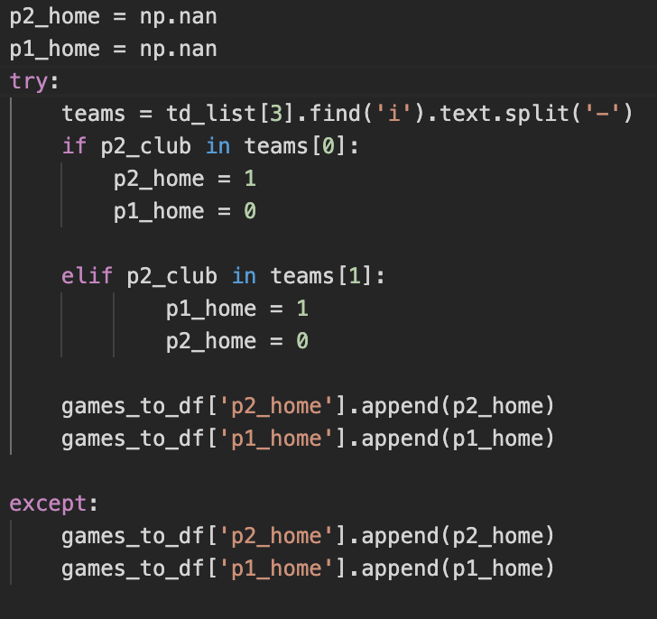
Difficulties during the crawling
In some cases the columns were not the same,
In addition the winner isn’t specified in each game row
And also the home / away.
We splatted the sets string and determined the winner, in league games we checked the clubs and compared it to each player club to check for home advantage

Slide 8

Processing the data

Slide 9
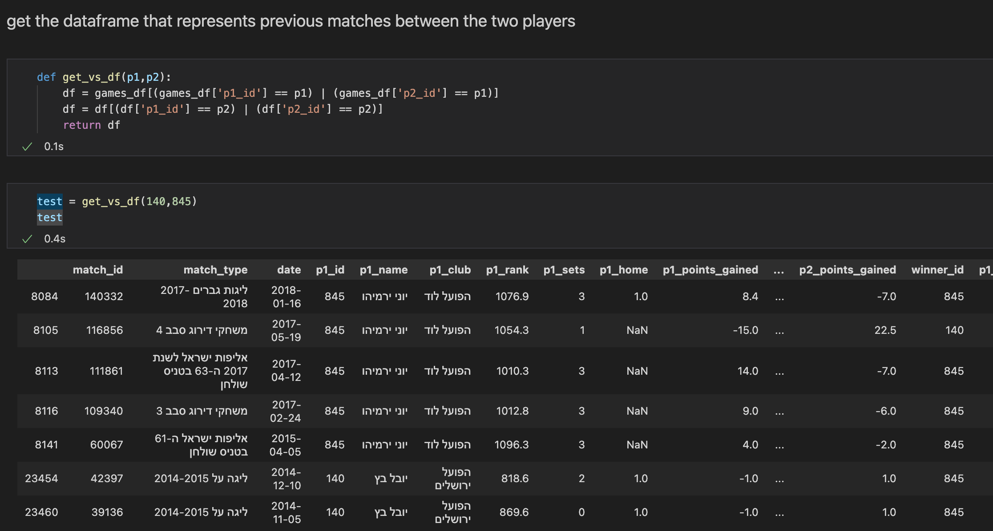
Processing
During the data processing step we wanted to achieve more columns that will be more effective during the machine learning phase.
The first thing we did is to create a function that returns two players history through the years

Slide 10
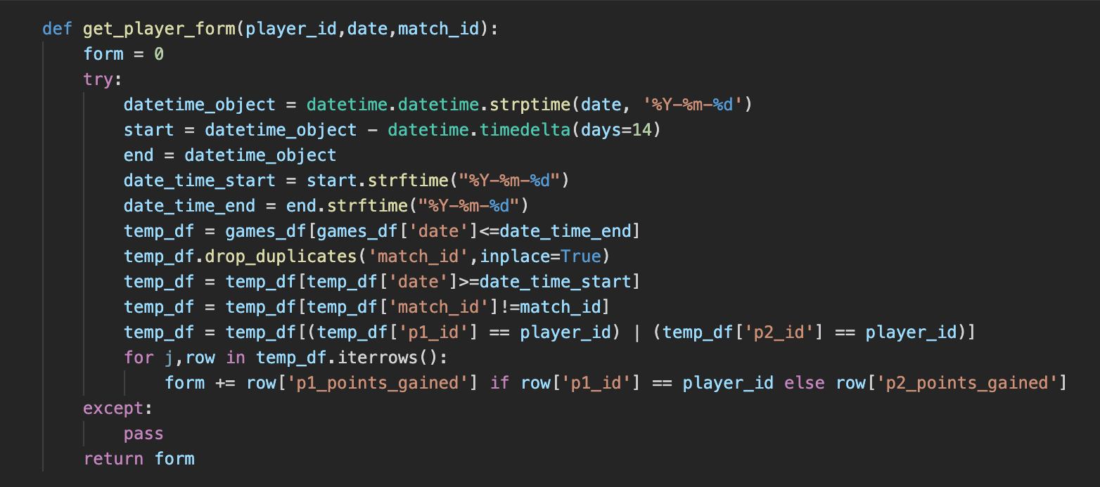
Later on we wanted to figure out each player’s form in each specific match.
We have decided on a column that represents the points he gained / lost over the past two weeks.
We created a function that receives the player’s id, the date of the match and the match id.
We iterate over the past 14 days and checked each time if the player had a match, if gained or lost points and returned his current form for this specific match.
For example, during a league match between two teams each player can play more than one game. So there might be an impact if he won the game before.

Slide 11
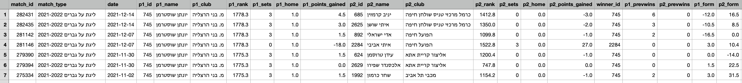
As active players we figured that there is a great impact of the two players match history to the outcome,
so we created a function that calculates each player wins on the opponent in the past and added two columns to the dataframe.
The function receives the dataframe of both players history that we made earlier and returns each player wins count.
After applying the function for each row the Dataframe looks like this:

Slide 12

EDA

Slide 13
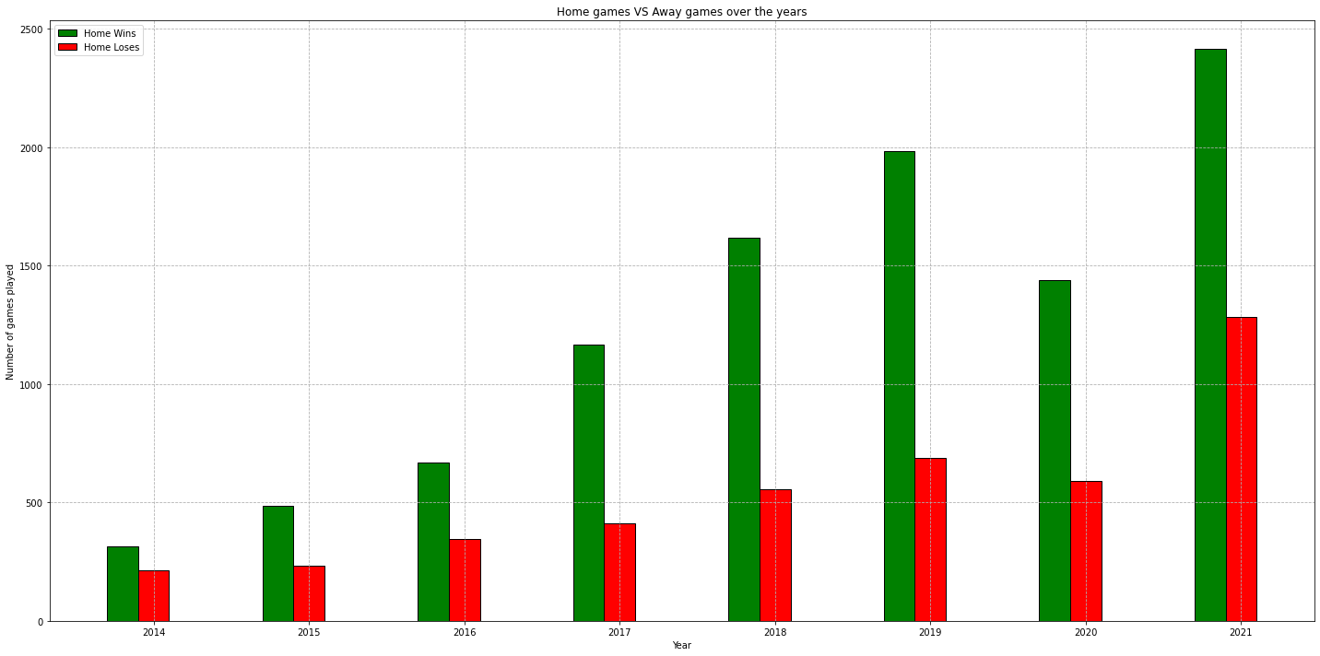
We tried to figure out if the match outcome is affected by the different stats we acquired earlier
The importance of a home game through the years

Slide 14
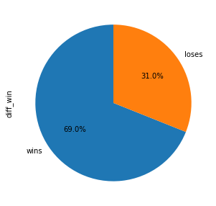
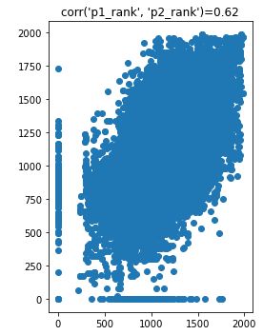
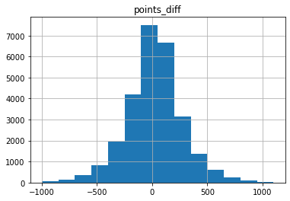
This is a very important graph for us,
It shows the percentage of games won / lost based
On the points difference between the players.
As we can see most wins are the matches that the player was ranked higher than his opponent
Points difference histogram

Slide 15
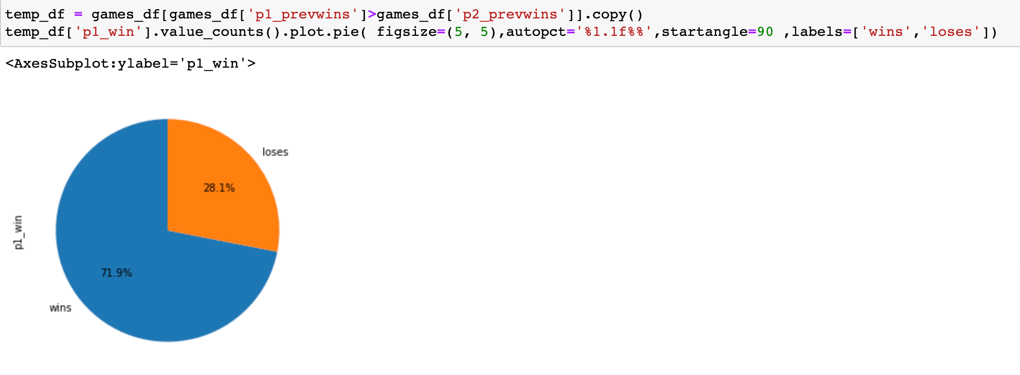
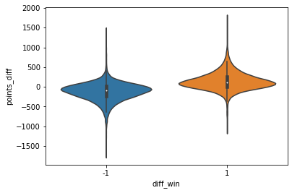
Here we can see the importance of the history between the two players.
71.9% of the matches that player1 had more wins over his opponent ended with a victory

Slide 16
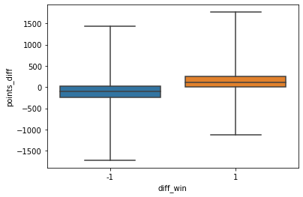
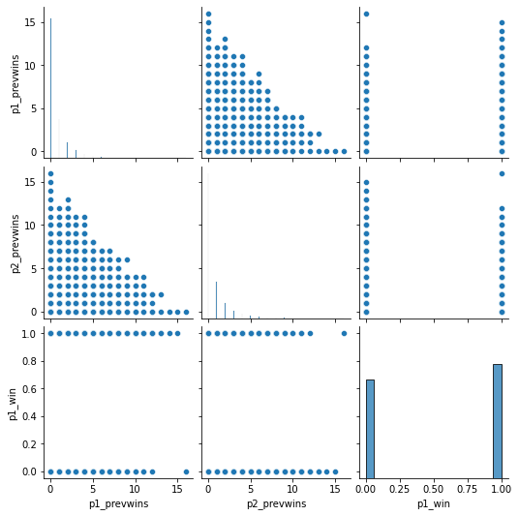
Games lost when the difference was negative

Slide 17
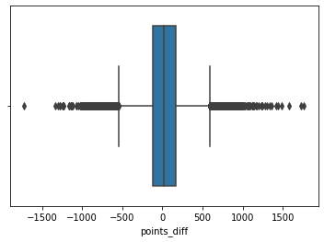
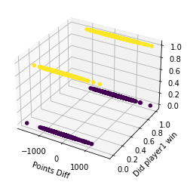
Trying to figure outliers. Most of the points difference is between +-500 points

Slide 18
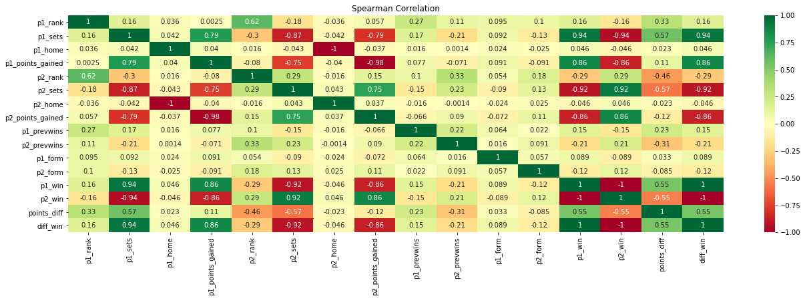

Slide 19
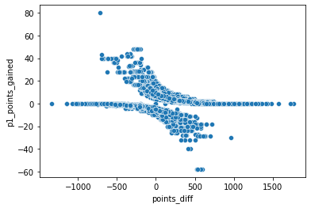
Player gains less points if he has higher rank than his opponent

Slide 20
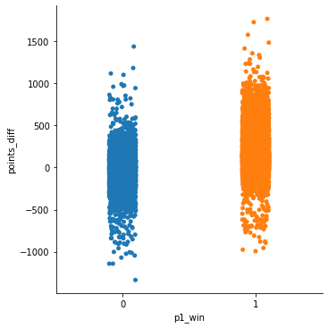
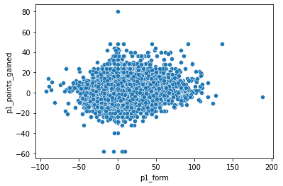
More likely to win when you have the points advantage

Slide 21

So our main question is
Can we predict the outcome of a given match between two players?

Slide 22

Machine Learning

Slide 23
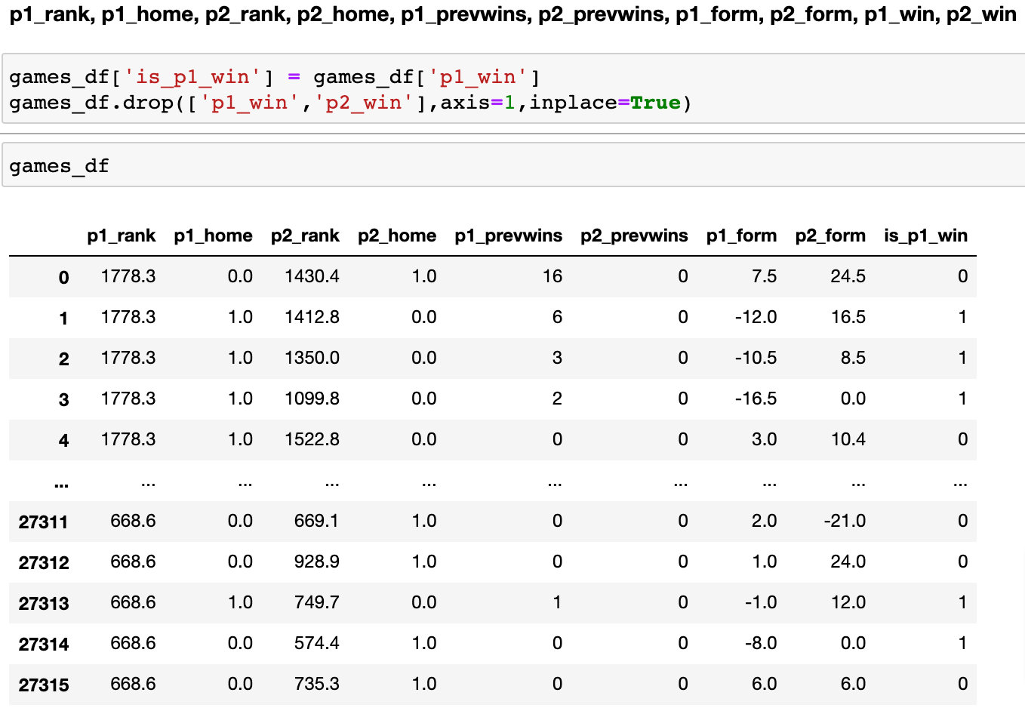
So is there any way, based on what we presented earlier to determine the outcome of a given match
We left the relevant columns for our model and the label column is will player1 will win

Slide 24
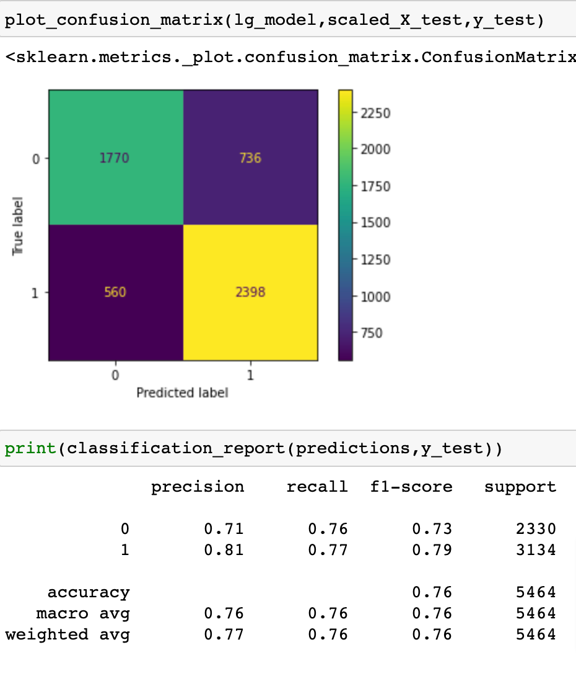
The first model we used:
Logistic Regression
The model gave a nice result of 76% accuracy but we wanted to know if we can improve our model

Slide 25
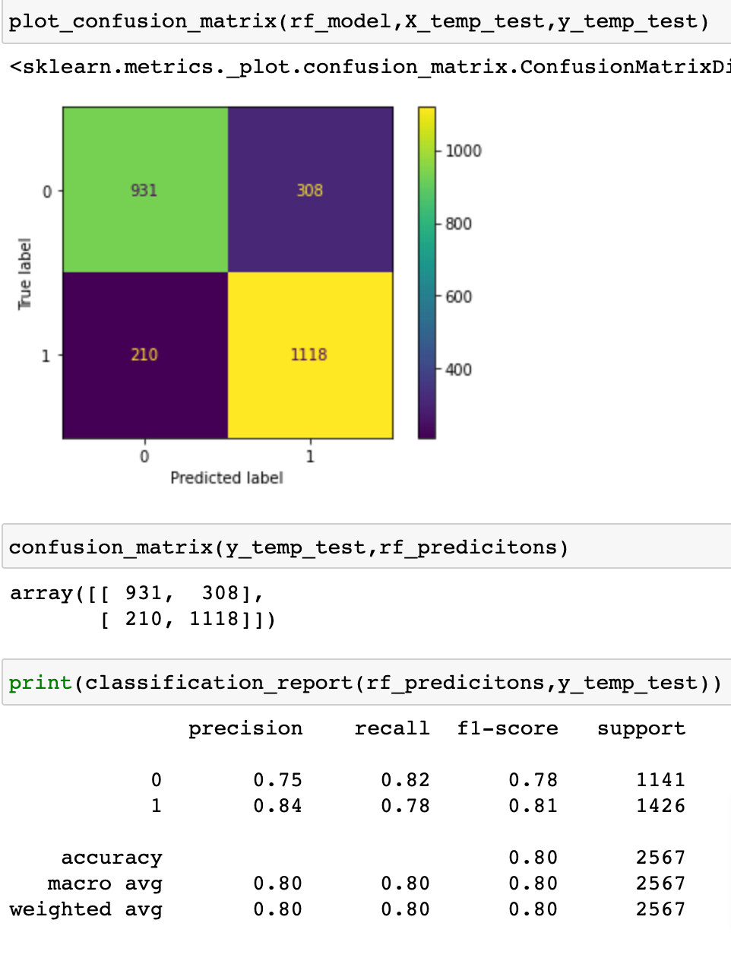
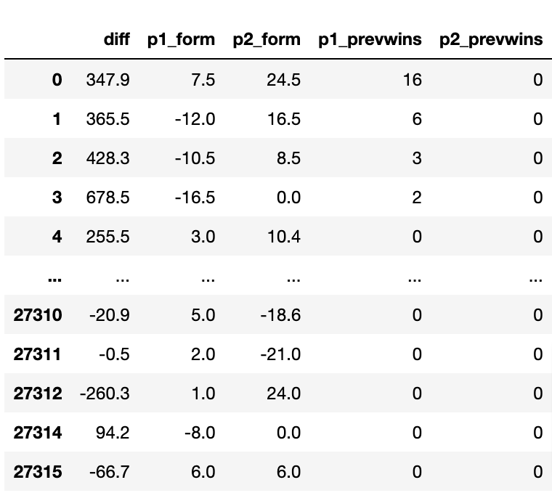
The second model we used:
Random Forest
Here the model predicted correctly 80% of the outcomes which is amazing
After some tests we found out that the home column is not preforming well in our model because of the fact that many games are played under the condition of “Neutral” field, so we merged the points column into one and removed the home columns and this is the dataframe we created:

Slide 26
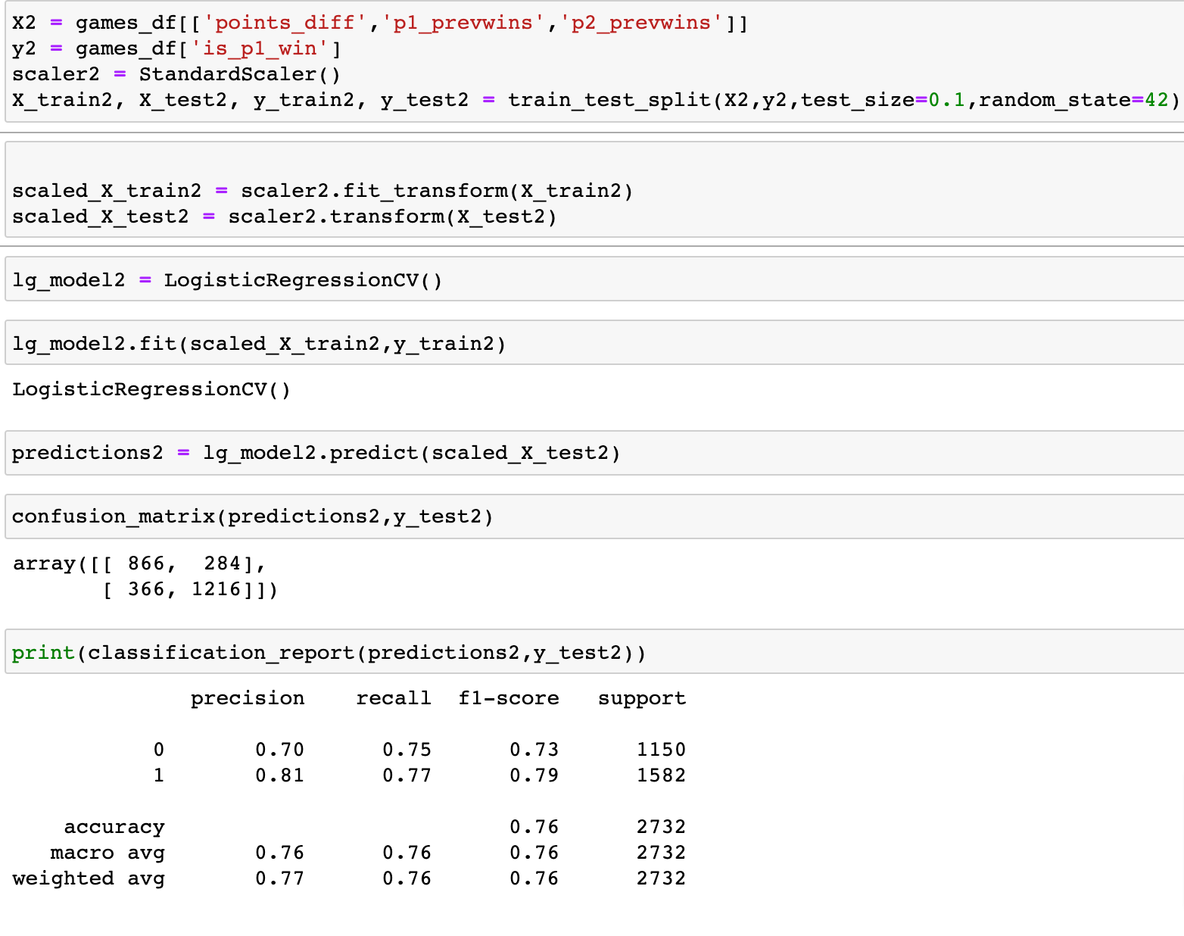
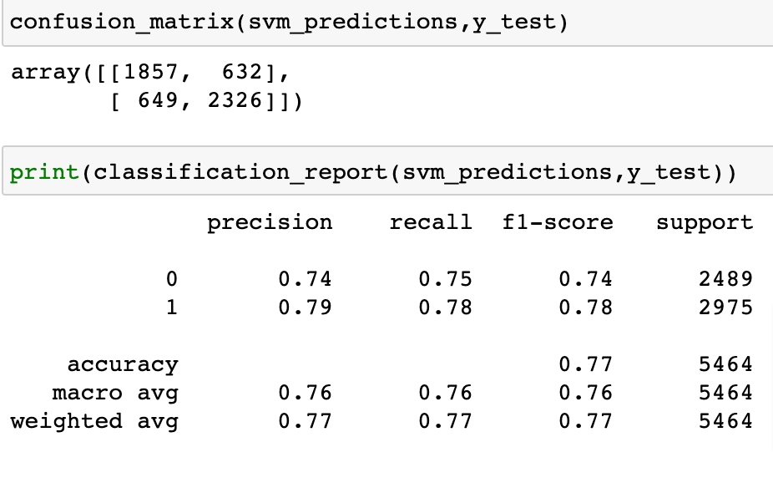
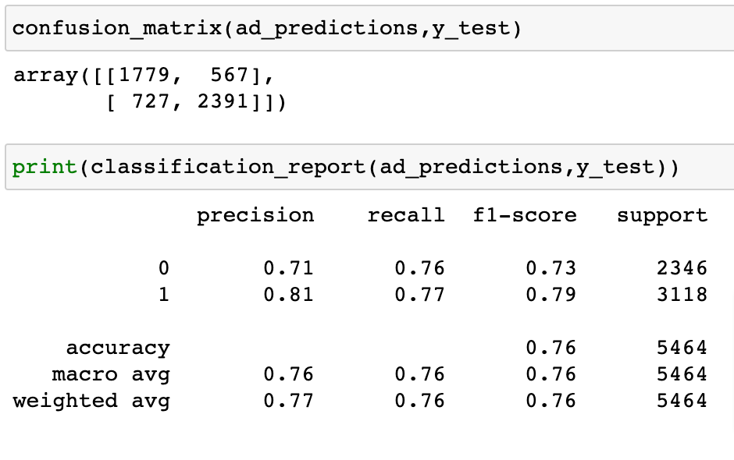
In addition we tried another 2 different models:
SVM and Adaptive Boost, which took a lot of energy from the computer and time, and yet gave us less satisfying results.
We tried a different approach with the logistic regression model but it didn’t preform as well

Slide 27

Eventually we found out that the best model for this data is Random Forest
We have decided to not submit the project as is, and create an interactive application that will be using all of what we achieved earlier in order to predict a future match.
We exported our model and with previous knowledge of web development we made an amazing application (currently local) that allows the user to select a player from the top 200
And with the machine learning model we exported it will be able to determine the outcome of a future game.
Here is a demonstration of the app, you can also go to the app’s GitHub page and try for yourself.

Slide 28
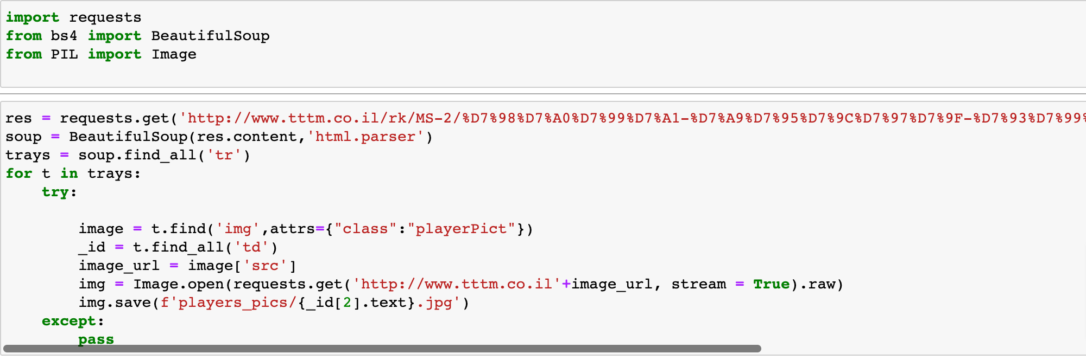
The app contains a Flask server, HTML CSS and Javascript,
Also all of the images were achieved by crawling through each player page and downloading them

Slide 29
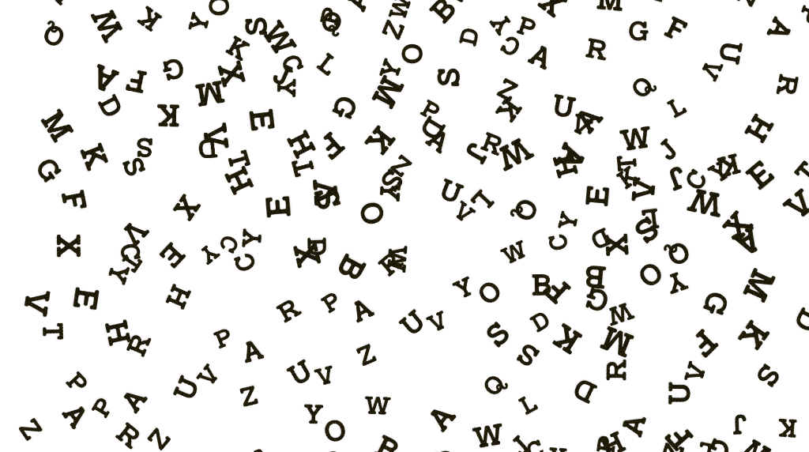
Final Words

